Slide 1
Operating Systems
SENS-3513
Week: 2
OS Structure & Services
Operating System Concepts
9th edition
Silberschatz, Galvin & Gagne
John Wiley & Sons
2013
Dr Nauman Mazhar
Faculty of Information Technology (FIT)
University of Central Punjab (UCP)

Slide 2
Outline
Interrupts & Exceptions
OS Protection
Dual Mode Operation
Operating System Services
User Interface
Programmer Interface - System Calls
OS Design / Structure
Unix / Linux directory structure
2

Slide 3
Interrupts
Operating system → Interrupt Driven
Interrupt – mechanism to allow system to respond to events & signals from H/W or S/W
  “Interrupt is an event/signal that
  temporarily halts normal execution of a process,
  to handle a specific event or request”
  Hardware Interrupt – from devices external to CPU
  Software Interrupt – from programs running on CPU
When interrupt occurs…
  current execution of program is paused
  control transferred to OS, to perform interrupt specific task
3
Notes:
Virtually all computers provide a mechanism by which other modules (I/O, memory) may interrupt the normal sequencing of the processor.
Interrupts are provided primarily as a way to improve processor utilization.
For example, most I/O devices are much slower than the processor.
Suppose that the processor is transferring data to a printer using the instruction cycle scheme described earlier.
After each write operation, the processor must pause and remain idle until the printer catches up.
The length of this pause may be on the order of many thousands or even millions of instruction cycles.
Clearly, this is a very wasteful use of the processor.

Slide 4
Interrupt Types
Type | Source | Generated By | Purpose | Examples
Hardware Interrupt | External devices | Device controller; send signal to CPU (via system bus) | Notify CPU that device needs attention | keyboard key press, mouse movement, Disk I/O complete, N/W pkt arrival
Software Interrupt | Executing program | System call mech, or explicit CPU instruction | User program request OS for service | System calls read(), write(), INT 0x80
Trap / Exception | Executing program | CPU detects error, or special condition | Handle errors, transfer control to OS for recovery | divide by zero, invalid memory access, page fault
Timer Interrupt | Internal hardware | System timer (programmable clock) | Enable multitasking & CPU scheduling | System timer generates interrupt every 10 ms

Slide 5
Interrupt Handling
When CPU receives Interrupt
  control transferred to a fixed location in memory
  gives starting address of Interrupt Service Routine
  ISR executed – performs interrupt specific action
When interrupt servicing is done
  CPU resumes execution of the interrupted process
  address of last instruction executed was earlier saved
  return address now reloaded in program counter (PC)
OS may also have saved CPU state, before handling the interrupt
  CPU state – values of CPU registers
  CPU state restored before resuming interrupted instruction
5

Slide 6
Interrupt Handling
How do Interrupts transfer control to appropriate ISR…???
Generic routine
  a generic ISR is invoked; examines interrupt related info
  calls the specific interrupt handler
  two step process
Interrupt Vector No. & Interrupt Descriptor Table
  IDT is a table of pointers stored in memory
  IDT indexed by Interrupt Vector number – identifies device or event
  each entry holds address of an ISR – for a specific device
  CPU uses interrupt vector to call ISR directly – no intermediary routine
  faster method
6

Slide 7
Simplified Linux IDT
Vector No. | Interrupt Source | Handler / ISR Function
0 | Divide-by-zero (CPU exception) | do_divide_error()
13 | General protection fault | do_general_protection()
14 | Page fault | do_page_fault()
32 | System timer (IRQ0) | timer_interrupt()
33 | Keyboard (IRQ1) | keyboard_interrupt()
46 | Disk controller (IRQ14) | ata_interrupt()
128 (0x80) | Software interrupt / System call | system_call()
7

Slide 8
Input Output (I/O)
Operation
8

Slide 9
Input Output Operation
Input/Output (I/O)
Transferring data between
main memory and external device,
such as disk, keyboard, printer, or network interface
  reading file from disk → memory
  sending data → printer or display
  receiving → network packets into memory
Methods of performing I/O :
  Polling based I/O
  Interrupt driven I/O
  DMA based I/O
9
Notes:
Virtually all computers provide a mechanism by which other modules (I/O, memory) may interrupt the normal sequencing of the processor.
Interrupts are provided primarily as a way to improve processor utilization.
For example, most I/O devices are much slower than the processor.
Suppose that the processor is transferring data to a printer using the instruction cycle scheme described earlier.
After each write operation, the processor must pause and remain idle until the printer catches up.
The length of this pause may be on the order of many thousands or even millions of instruction cycles.
Clearly, this is a very wasteful use of the processor.

Slide 10
Input Output (I/O)
Polling Based I/O
User process requests I/O → system calls – read(), write()
CPU repeatedly checks in a loop :
  is device ready to perform I/O…??
When device is ready :
  CPU transfers data between device / memory
During transfer process, CPU remains busy handling I/O operation
  simple & inefficient
  but wastage of CPU time – CPU keeps waiting for transfer to complete
  CPU could have performed other useful work..!!
10
Notes:
Virtually all computers provide a mechanism by which other modules (I/O, memory) may interrupt the normal sequencing of the processor.
Interrupts are provided primarily as a way to improve processor utilization.
For example, most I/O devices are much slower than the processor.
Suppose that the processor is transferring data to a printer using the instruction cycle scheme described earlier.
After each write operation, the processor must pause and remain idle until the printer catches up.
The length of this pause may be on the order of many thousands or even millions of instruction cycles.
Clearly, this is a very wasteful use of the processor.

Slide 11
Input Output (I/O)
Interrupt Driven I/O
For I/O operation, process requests the OS (System Call)
  system call handler calls device driver →
  device controller configures device controller → starts I/O
  CPU → back to earlier processing (now free for other tasks)
When I/O completes, device controller generates interrupt
  CPU → transfers control to ISR
  ISR → processes interrupt & returns
  CPU → completes the transfer, or schedules next block
Device interrupts CPU for each block of data transferred
  CPU has to frequently handle data transfers & context switches
  But CPU not continuously busy with device..!!
11
Notes:
Virtually all computers provide a mechanism by which other modules (I/O, memory) may interrupt the normal sequencing of the processor.
Interrupts are provided primarily as a way to improve processor utilization.
For example, most I/O devices are much slower than the processor.
Suppose that the processor is transferring data to a printer using the instruction cycle scheme described earlier.
After each write operation, the processor must pause and remain idle until the printer catches up.
The length of this pause may be on the order of many thousands or even millions of instruction cycles.
Clearly, this is a very wasteful use of the processor.

Slide 12
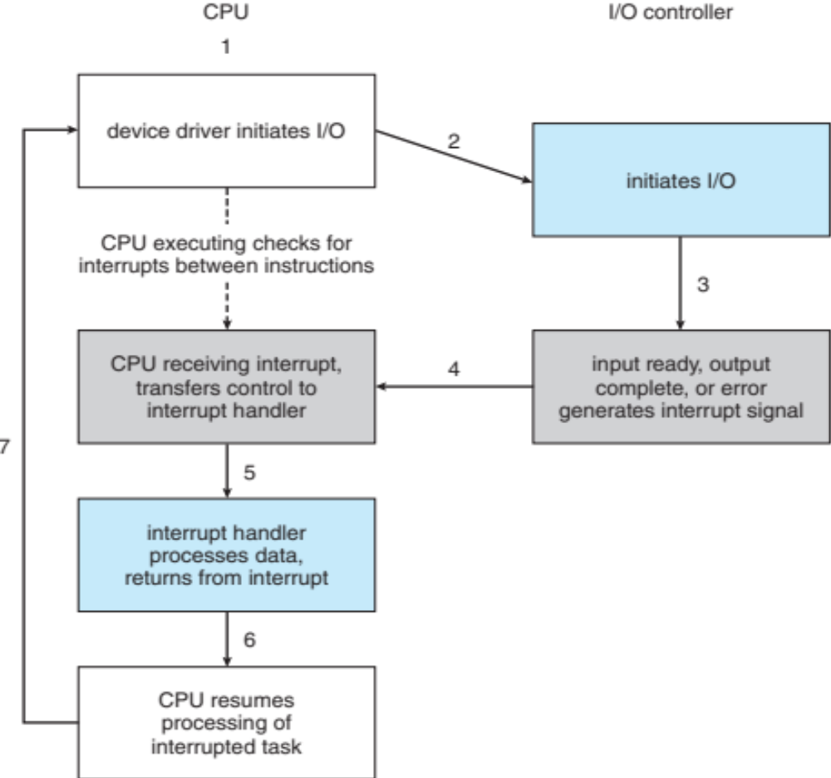
Interrupt driven
I/O Cycle
12

Slide 13
Input Output (I/O)
Direct Memory Access (DMA)
Allows data transfer directly between device & main memory,
without continuous involvement of CPU
User process requests I/O → system calls – read(), write()
CPU thru device driver, programs DMA controller → source/destination
DMA controller transfers data directly between device & memory
  No CPU involvement
When transfer complete :
  DMA controller generates interrupt to notify CPU
  CPU wakes up the waiting process
Efficient for large or high-speed data transfers
13
Notes:
Virtually all computers provide a mechanism by which other modules (I/O, memory) may interrupt the normal sequencing of the processor.
Interrupts are provided primarily as a way to improve processor utilization.
For example, most I/O devices are much slower than the processor.
Suppose that the processor is transferring data to a printer using the instruction cycle scheme described earlier.
After each write operation, the processor must pause and remain idle until the printer catches up.
The length of this pause may be on the order of many thousands or even millions of instruction cycles.
Clearly, this is a very wasteful use of the processor.

Slide 14
Input Output (I/O)
I/O Method | Who Transfers Data | CPU Role | Efficiency
Polling Based I/O | CPU | Actively checks device, moves data itself | Low
Interrupt Driven I/O | CPU (in ISR) | Waits for interrupt for each block of data, then moves more data | Medium
DMA Based I/O | DMA Controller | Sets up DMA transfer, then free until completion | High
14

Slide 15
OS Protection &
Dual Mode Operation
15

Slide 16
Protection
In time sharing systems, error in one program can potentially cause harm to other programs or system :
  directly send commands to hard disk, to overwrite files of some other program
  directly access memory of some other program, to alter their data or leak passwords
Need to prevent user level code
from performing privileged operations
that can potentially harm other programs, or the system
CPU Modes of Operation – provide protection
  User mode
  Kernel mode (also monitor/system/supervisor mode)
16

Slide 17
Dual Mode Operation
  Use of CPU Mode bit prevents user level code
  from executing privileged instructions
  that can potentially harm other programs, or the system
CPU Mode bit – stored in Processor Status Register
  mode bit “0” CPU in Kernel mode → kernel code running
  mode bit “1” CPU in User mode → user code running
CPU instructions to perform privileged operations → executed only with CPU in kernel mode
  user process cannot set mode bit to “kernel”
  need to request OS for privileged tasks
17

Slide 18
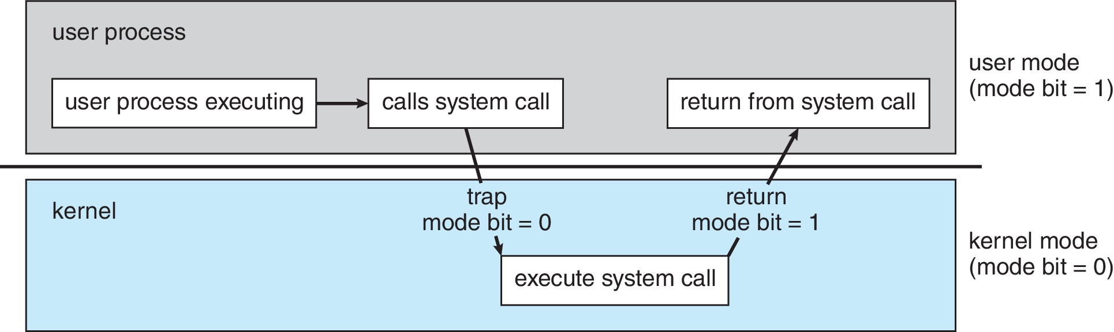
Transition - User to Kernel Mode
User level code makes a System Call – request OS kernel for privileged operation
  generates software interrupt
  CPU switches to kernel mode
  kernel code then runs to perform the
  privileged operation
Interrupt
kernel
user
set user mode
18

Slide 19
Protecting Processes
How to protect processes…!!
Protection of I/O devices
  User code should not have direct access to I/O device
Protection of Memory
  One user process should not be able to access address space
  of another process
Preemptive switching from task to task
  User code must not be able to disable/alter CPU timer
19

Slide 20
I/O Protection
All I/O instructions are privileged instructions
  user process not allowed to execute I/O instructions directly
Users request I/O via System Calls
  OS then performs the I/O operation – open/read file
Use of System call in Linux to display ‘msg’ on monitor screen
  mov eax, 4 ; load system call number for sys_write
  mov ebx, 1 ; specify file descriptor 1 → stdout
  mov ecx, msg ; address of message
  mov edx, len ; number of bytes to write
  int 0x80 ; generate software interrupt → kernel performs write()
20

Slide 21
Memory Protection
Process Address Space
  when loaded, each process is allocated memory space
  process can legally access only its own region in main memory
  no access allowed outside its address space
Implementation
  CPU uses two registers to restrict a process within its own address space – range of memory addresses
  Base Register
    holds starting address of “Address Space” assigned to process
  Limit Register
    contains size of “Address Space” allocated to process
21

Slide 22
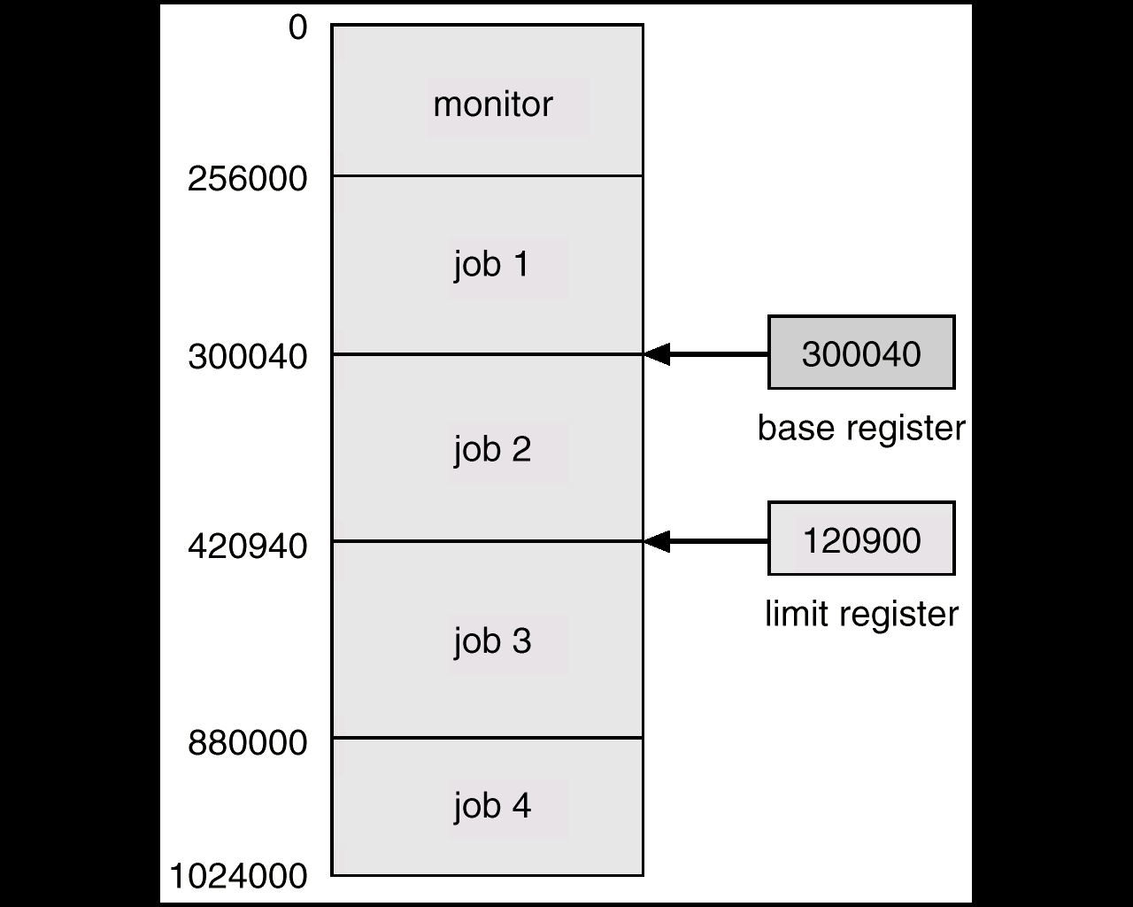
Memory Protection
22

Slide 23
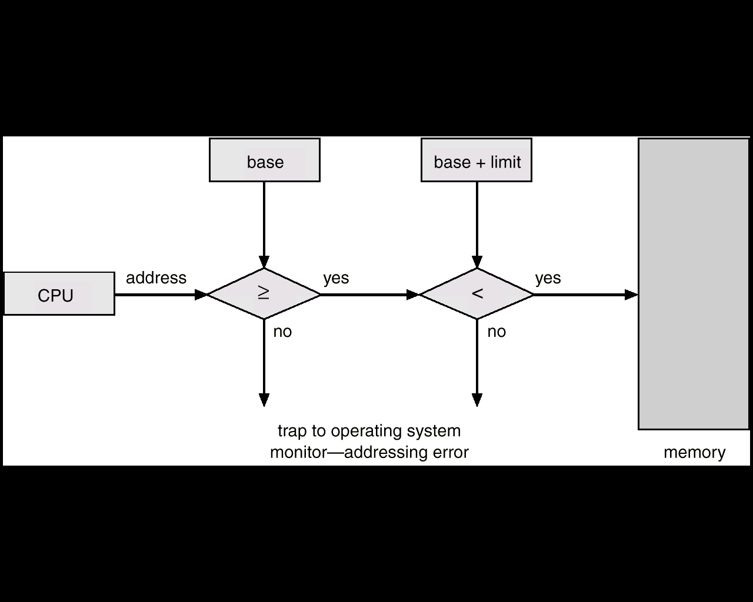
Memory Protection
23

Slide 24
CPU Protection
In multitasking/time-sharing, many processes need execution
  CPU must not stay with one process indefinitely
Protection implementation
  Timer used to generate interrupt after specified time period
  timer (counter register) loaded with predefined time value & decremented every clock tick
  when timer value==0, interrupt occurs
  ISR executed → CPU switches to another process
How Timer is loaded
  by using a privileged instruction
  only admin can assign time slice to processes
24

Slide 25
Operating System Services
25

Slide 26
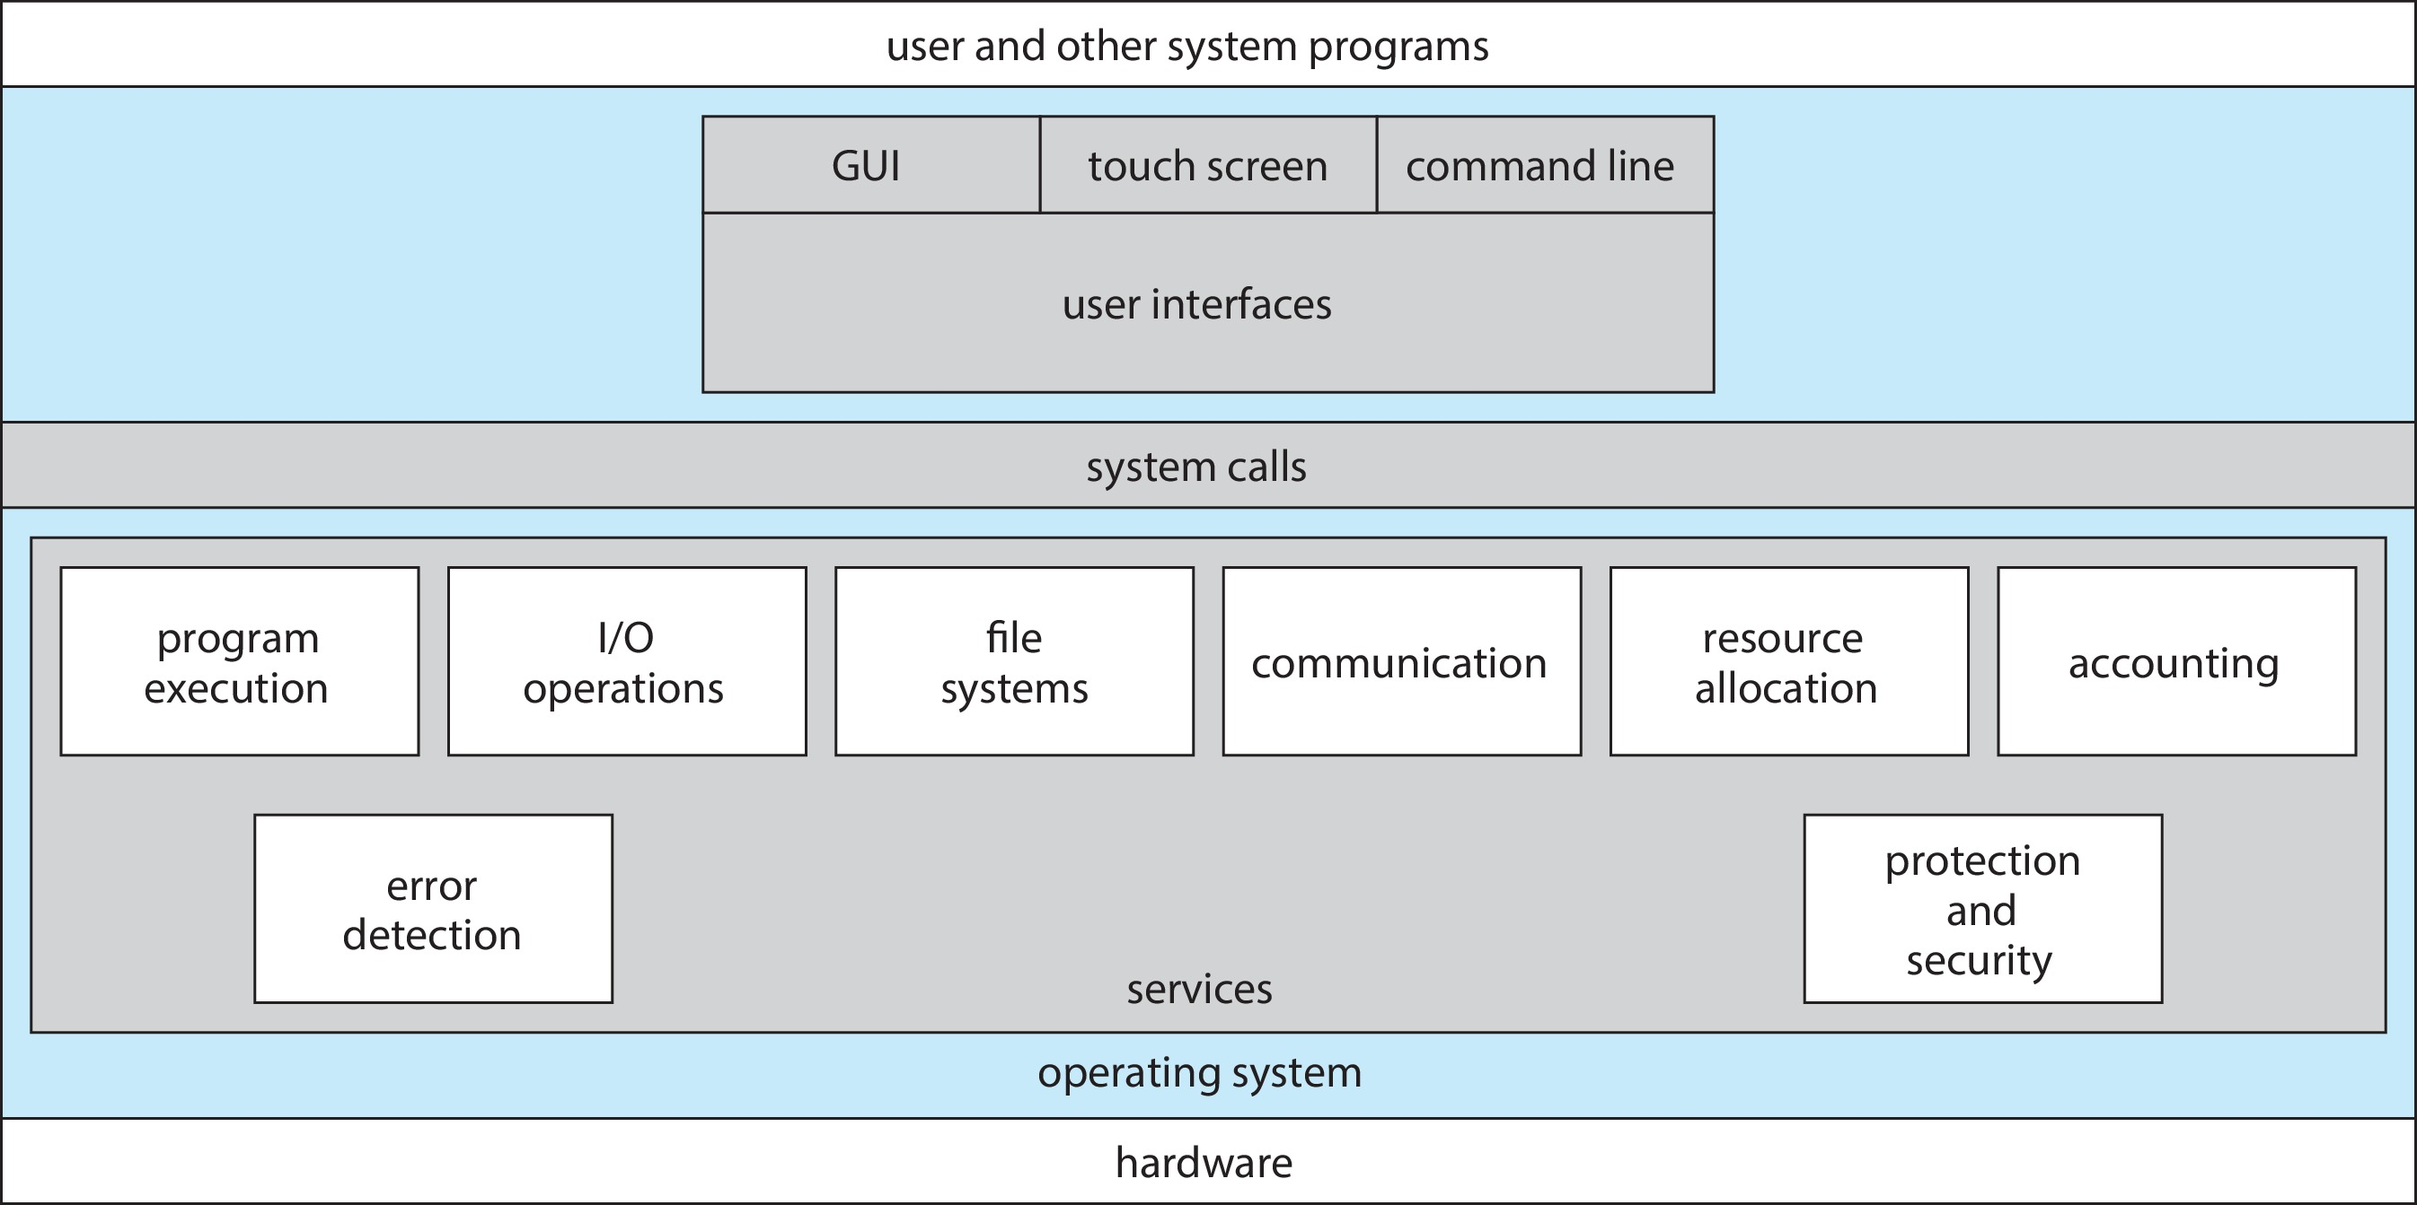
Operating System Services
26

Slide 27
OS Services
Services Helpful to Users
User Interface – almost all OS have user interface (UI)
  Command-Line (CLI)
  Graphics User Interface (GUI)
  Touch-screen
Program execution – system must be able to:
  load programs into memory, & run
  end execution, normally or abnormally (indicating error)
I/O operations – running program may require I/O
  may involve a file, or I/O device
  users cannot control I/O devices, OS must provide the means
27

Slide 28
OS Services
File-system manipulation – programs need to:
  read/write files & directories list file Info
  create, search & delete files manage permissions
Communications – processes may exchange information:
  on same computer, or between computers over network
  via pipes, shared memory, or message passing
Error detection – constantly be aware of possible errors:
  may occur in CPU, memory, I/O devices, user programs
  OS to take appropriate action for correct & consistent computing
  debugging facility also allows users & programmers to use system efficiently
28

Slide 29
OS Services
Services for Efficient System Op
Resource allocation – when multiple users or jobs run concurrently, resources need to be allocated
  (CPU cycles, main memory, file storage, I/O devices)
Logging – keep track of which user is using how much resources, what activities are performed by whom
Protection & security – in multiuser or networked systems, owners need to control access to info/resources
  Controlled access – concurrent processes not to interfere
  with each other
  User authentication – protect I/O devices from invalid access
  attempts
29

Slide 30
User Interface
30

Slide 31
Command Line Interface
Text-based method to interact with computer system
  usually implemented as System program
Interacts with OS kernel to manage & control the system
“Allows users to directly communicate with OS or
an executing program”
  text-based commands & text-based responses
  specific syntax for commands; perform particular action
  common tasks include:
  file management, software installation & configuration,
  running scripts, system administration, etc
Multiple flavors implemented – shells
31

Slide 32
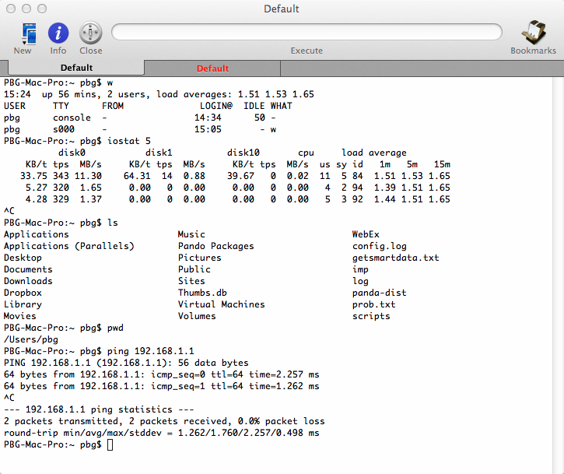
Bourne Shell
32

Slide 33
GUI
Graphical User Interface – user friendly way to interact with the system
  Icons → files, programs, actions, etc
  commands entered by moving cursor & clicking
  (use mouse, keyboard, touchscreen)
  cursor over objects in GUI cause various actions
  (provide info, options, execute function, open folder)
Many OS include both CLI & GUI interfaces
  MS Windows is GUI based, with CLI based “command” shell
  Apple Mac OS X has “Aqua” GUI, with shell facility
  Unix / Linux have both CLI & GUI (KDE, GNOME)
33

Slide 34
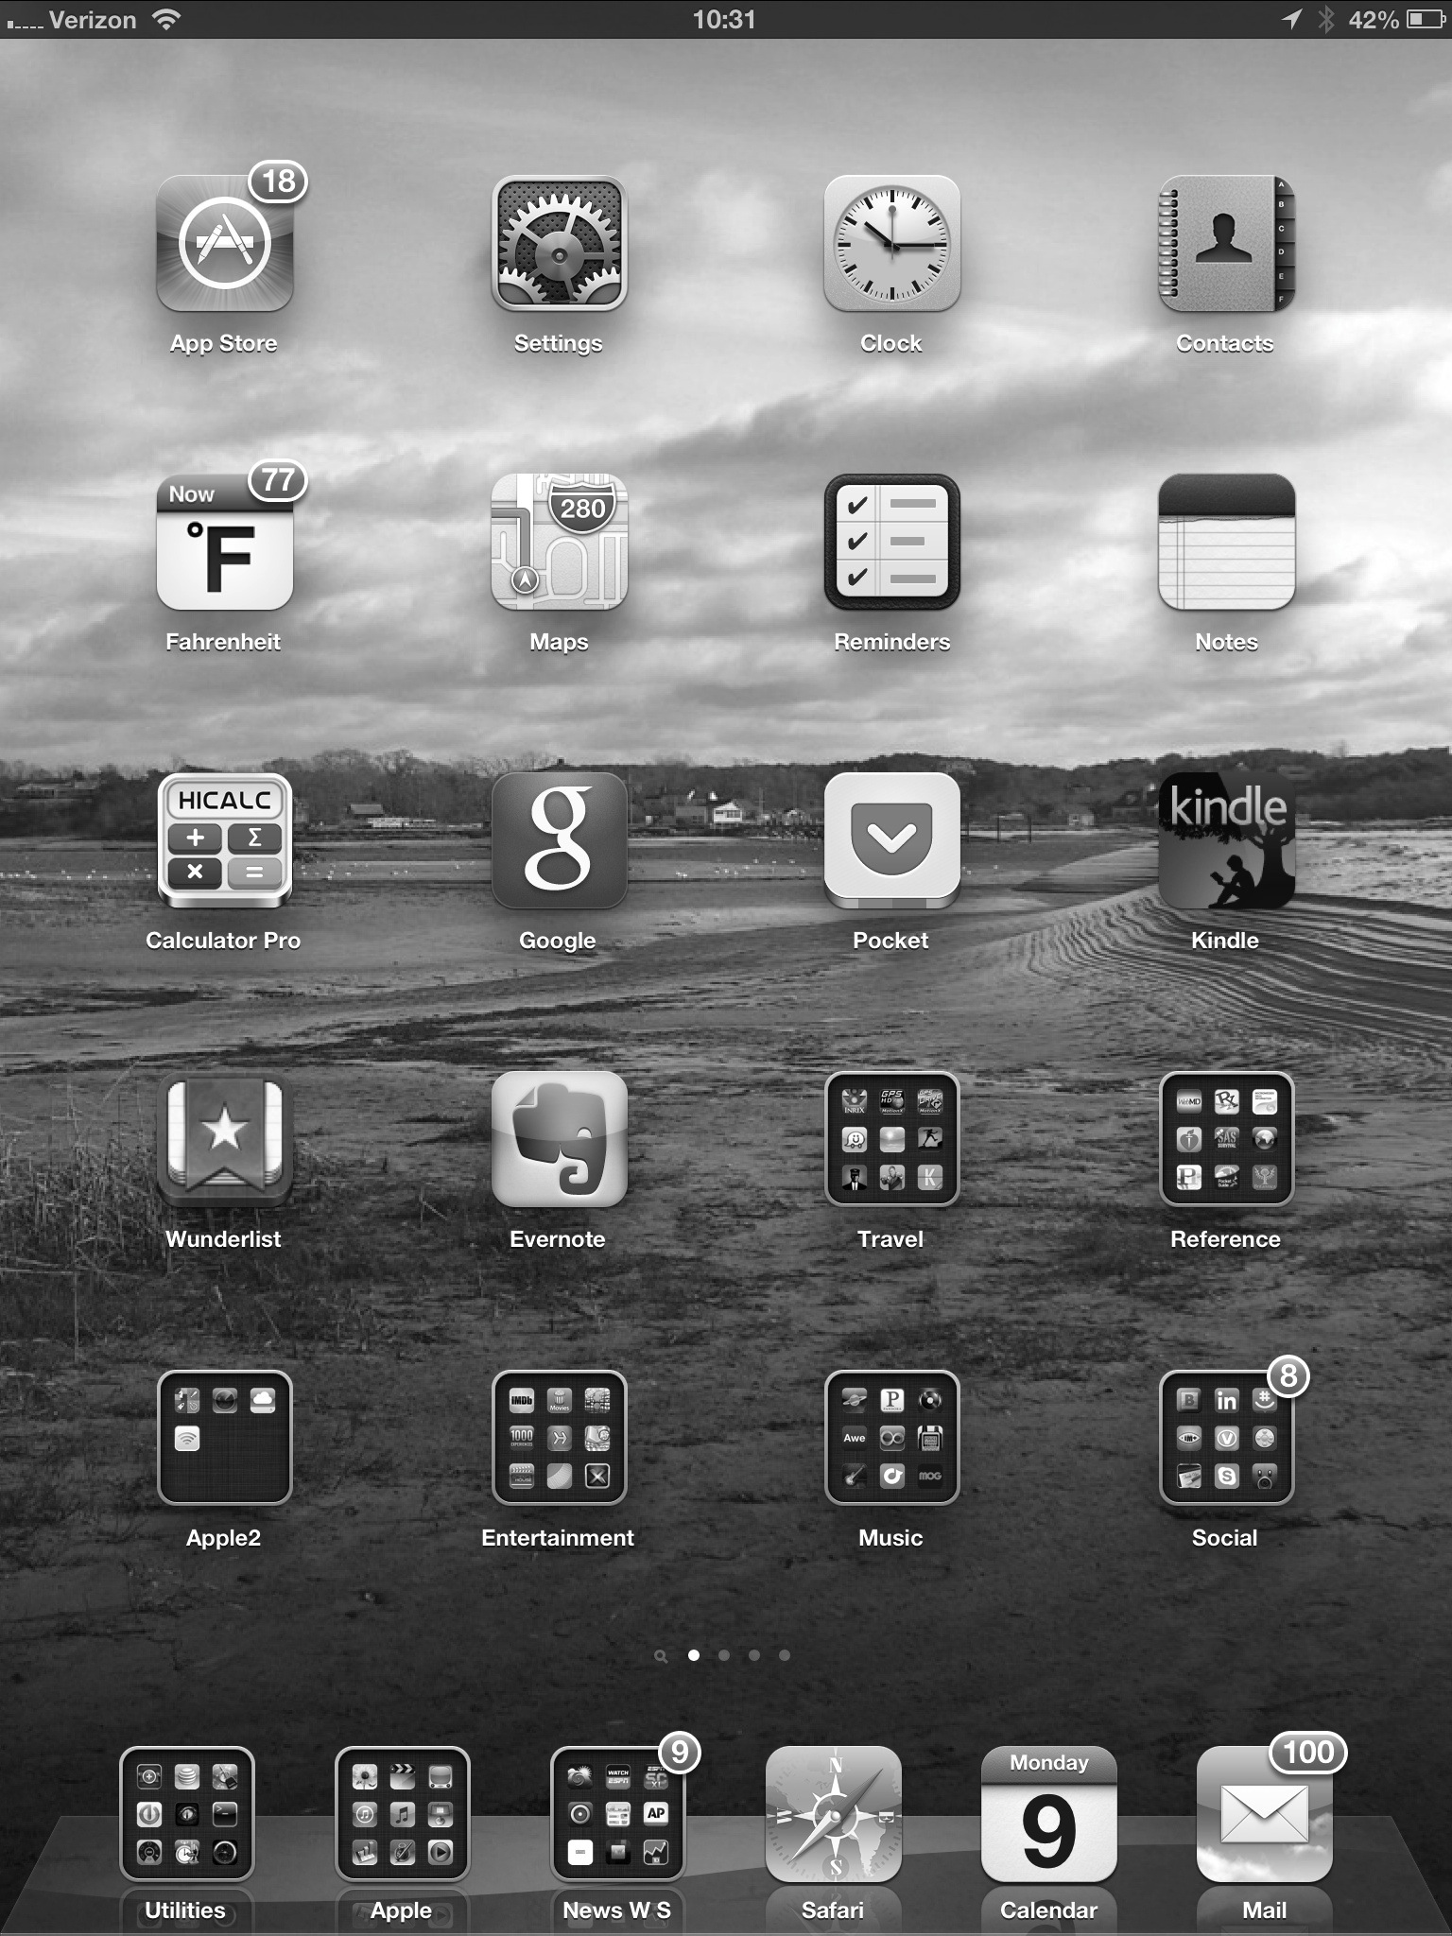
Touchscreen Interfaces
Touchscreen devices require new interfaces
  mouse not possible, or
  not desired
  actions & selection based on gestures
  (tap, swipe, long press,
  pinch & zoom)
  virtual keyboard for text entry
  voice commands
34

Slide 35
Programmer Interface
System Calls
35

Slide 36
System Calls
“System call is an interface between OS & User programs”
Allows user-level process to request services from OS
  controlled way for programs to perform privileged operations
Common examples:
  File operations: open(), read(), write(), close()
  Process control: fork(), exec(), exit()
System calls are made available in OS as callable routines
  written in high-level language (C or C++)
  part of kernel code
  run in kernel mode
36

Slide 37
System Calls
User programs access system calls via an API
Set of std C/C++ library functions (glibc) available to Apps
API function call invokes relevant OS System Call
  generates software interrupt – INT 80h in Unix/Linux
Common APIs:
  Win32 API : for Windows
  POSIX API : for POSIX-based systems (UNIX, Linux, Mac OS X)
37

Slide 38
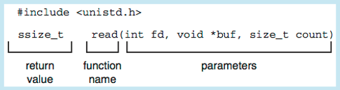
Example of Standard API
API for system calls & library functions obtained from “man pages”
Consider standard C / C++ library function read()
int fd : file descriptor to be used
void *buf : buffer where data will be read
size_t count : max number of bytes to be read into buf
returns number of bytes read
return value 0 → end of file
return value -1 → error
38

Slide 39
Example – System calls
int main ( ) {
int fd = open ( "example.txt", O_CREAT | O_WRONLY );
const char* message = "Hello, system calls…\n";
write ( fd, message, strlen (message) );
close ( fd );
char buffer [ 100 ];
fd = open ( "example.txt", O_RDONLY );
ssize_t bytesRead = read ( fd, buffer, sizeof (buffer) );
buffer [bytesRead] = '\0';
printf ( "Read from file: %s", buffer );
close ( fd );
return 0;
}

Slide 40
System Call Interface
OS provides a System Call Interface
  maintains System call table, indexed by System call numbers
  table has function pointers, for each system call
To make a system call, user-level process calls an API function
  API function triggers s/w interrupt, specifying System call number
  CPU switches to kernel mode, transfers control to System call handler
  System call handler uses System call number to locate/invoke the
  kernel function from System call table
  kernel function performs the requested operation
  CPU switches back to user mode,
  returns control back to user program
40

Slide 41
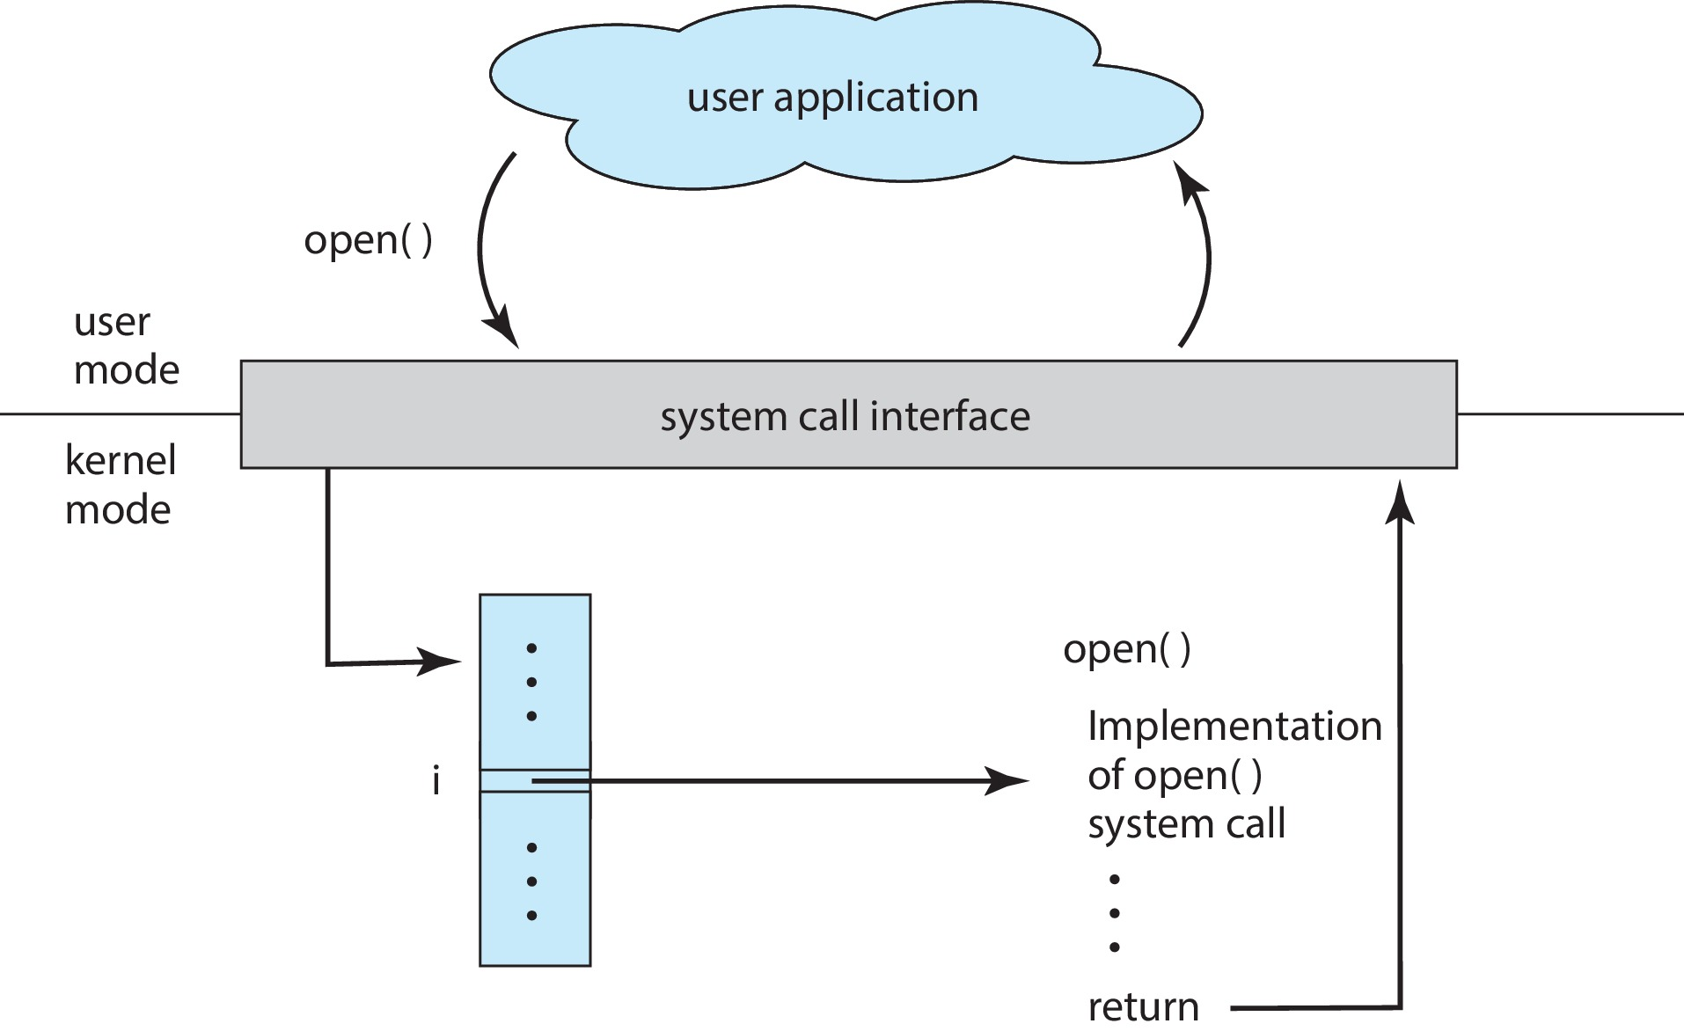
System Call Interface
41

Slide 42
System Call Parameter Passing
When system call is made, program may also need to pass parameters – file descriptor, buffer, flags
Three general methods to pass parameters to kernel:
  Pass parameters in CPU registers – simplest
    parameters may be more than registers
  Parameters stored in memory – block or table
    address of block passed as parameter in a register
    approach taken by Linux & Solaris
  Parameters pushed onto stack – popped off by OS
  block & stack methods do not limit the number or length
  of parameters
42

Slide 43
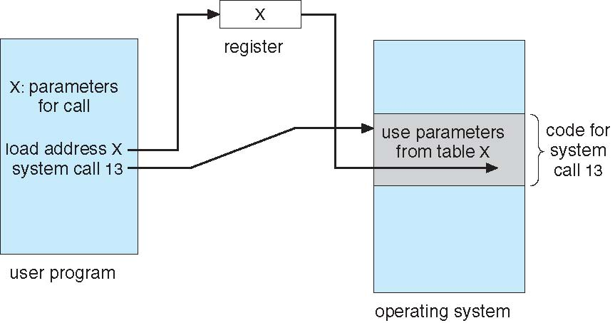
Parameter Passing via Table
43

Slide 44
Types of System Calls
Process control
  create process, terminate process
  load, execute
  get process attributes, set process attributes
  allocate & free memory
  dump memory, if error
  wait for time
  wait event, signal event
  Debugger for determining bugs, single step execution
  Locks for managing access to shared data between processes
44

Slide 45
Types of System Calls
File management
  create file, delete file
  open, close file
  read, write, reposition
  get & set file attributes
Device management
  request device, release device
  read, write, reposition
  get & set device attributes
  logically attach or detach devices
45

Slide 46
Types of System Calls
Information maintenance
  get & set time/date
  get & set system data
  get & set process, file, or device attributes
Communications
  create, delete communication connection
  Message passing model – send, receive messages
    to host name or process name
    from client to server
  Shared-memory model – create & gain access to memory regions
  transfer status information
  attach & detach remote devices
46

Slide 47
Types of System Calls
Protection
  Control access to resources
  Get & set permissions
  Allow & deny user access
47

Slide 48
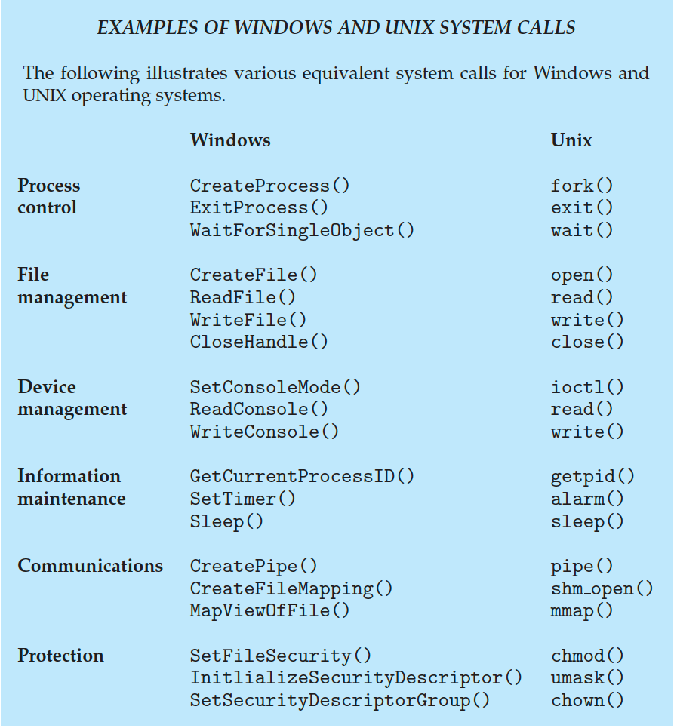
48

Slide 49
System Programs
OS provides a collection of system programs :
“Essential Apps & utilities, allow Users to interact directly with OS,
to manage & control the system”
Some are simply User Interfaces to System calls
  allow to interact with OS, instead of direct system call
  commands – ‘mkdir’, ‘chdir’, ‘rmdir’, ‘kill’
Others offer additional functionality – System Utilities
  higher level data processing & automation
  ‘grep’ – advanced text search, involves multiple system calls
  ‘netstat’ – system utility, displays list of network connections
System programs are divided into different categories
49

Slide 50
System Programs
File management
  manipulate files/directories
  create, delete, copy, rename, print, dump, list
Status information
  system info – date, time, available memory, disk space, number of users
  detailed performance, logging & debugging info
  format & print output to terminal, or other output devices
  implement registry – to store & retrieve configuration info
Programming language support
  compilers, assemblers, interpreters, & debuggers
50

Slide 51
System Programs
File modification
  text editors, as part of OS default set of tools
  often lightweight, and may lack advanced features found in dedicated text editing applications
Program loading & execution
  absolute loaders, relocatable loaders, linkage editors, overlay loaders, debugging systems for high-level & machine language
Communications
  mechanism to create virtual connections among processes, users & computer systems
  users can send messages to other screens, browse web pages,
  send emails, log-in remotely, transfer files
51

Slide 52
System Programs
Background services
  certain system programs launched at boot time – may terminate after task completion
  some keep running in background till shutdown – known as services, subsystems, daemons
  provide facilities – disk checking, error monitoring service, print servers, launch processes as per some schedule
Application programs
  most OS supplied with programs to be run/used by users
  e.g, web browsers, word processors, spreadsheets, games, etc
  not considered part of OS
52

Slide 53
OS Structure
53

Slide 54
Operating System Structure
General purpose OS is a very large program
  needs careful designing
  for proper functioning & modifiability
Various ways to structure an OS
  Monolithic – UNIX
  Layered – an abstraction
  Microkernel – Mach
  Modules – Linux, Solaris
  Hybrid Systems – macOS, iOS, Android
54

Slide 55
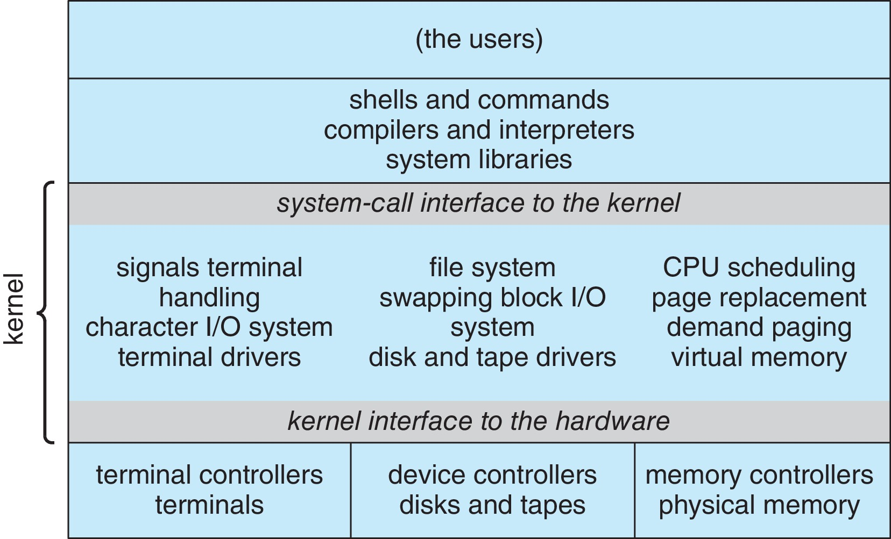
Monolithic Structure – Original UNIX
Original Unix OS had limited structuring – Monolithic
  entire OS a single large program – running in kernel mode
  contained all essential functions & services
  included Kernel & System programs
Kernel…
  everything below
  system call interface
  & above H/W
  included :
  CPU scheduling,
  memory management,
  file system,
  device drivers
55

Slide 56
Monolithic Structure – Original UNIX
Monolithic structure :
  difficult to implement, maintain, & extend
  efficient in terms of performance
  less overhead in comm within kernel, or system call interface
56

Slide 57
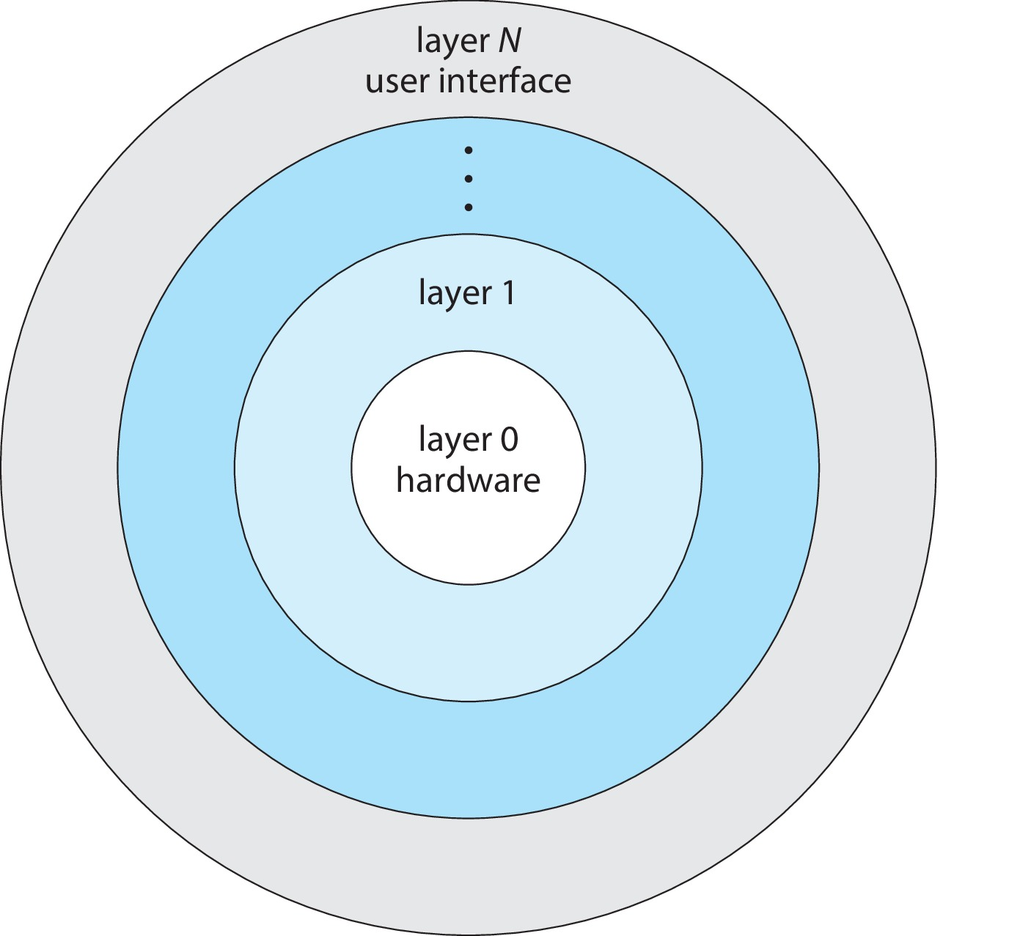
Layered Approach
OS divided into different layers :
  each layer responsible for some
  function/service
  bottom layer – H/W (layer 0)
  top – user interface (layer N)
  layer can use services only of
  its lower layer
Clear separation of functions
  easier to implement / maintain
Performance issue – interaction between layers
  traverse multiple layers for system calls – overhead of processing/comm
  problem in assigning layer functions
57

Slide 58
Microkernels
Small kernel – min functionality in core OS
  additional components & services → system/user level programs
  interaction between apps & services → only thru microkernel
Kernel main function – message passing
between client programs & services running in user space
  easier to extend – new services added in user space
  more reliable & secure – less code running in kernel mode
  performance overhead – user to kernel space comm
Mach operating system used microkernel approach
  macOS kernel (Darwin) partly based on Mach
58

Slide 59
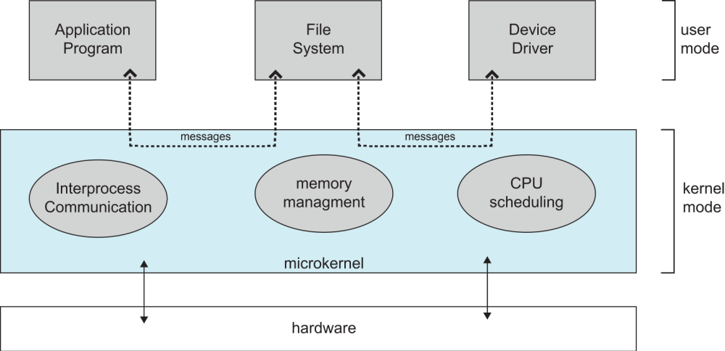
Microkernel System Structure
59

Slide 60
Modules
Loadable Kernel Modules – current best design methodology
Kernel provides small set of core services
  scheduling, memory management, IPC, etc
Additional functions added dynamically
  modules loaded at runtime – or boot time
  modules – device drivers, file systems, network protocols, security
“Kernel can be extended / modified without the need to
recompile or reboot entire OS”
Similar to layers model, but more flexible
  any module can call any other module
  Linux, Solaris, etc
60

Slide 61
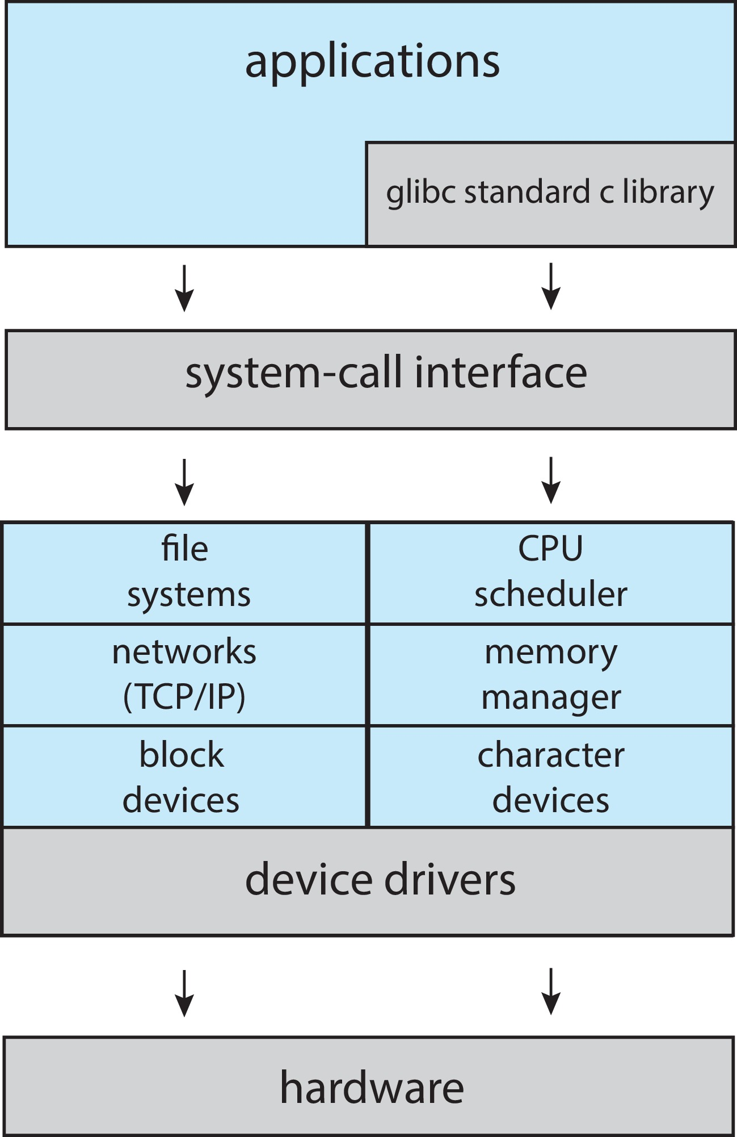
Linux System Structure
Monolithic plus Modular design
Kernel runs as single program, provides core system functions
Support for loadable kernel modules
  loaded & unloaded dynamically at runtime
  loadable modules include;
  device drivers, file systems,
  & additional features
61

Slide 62
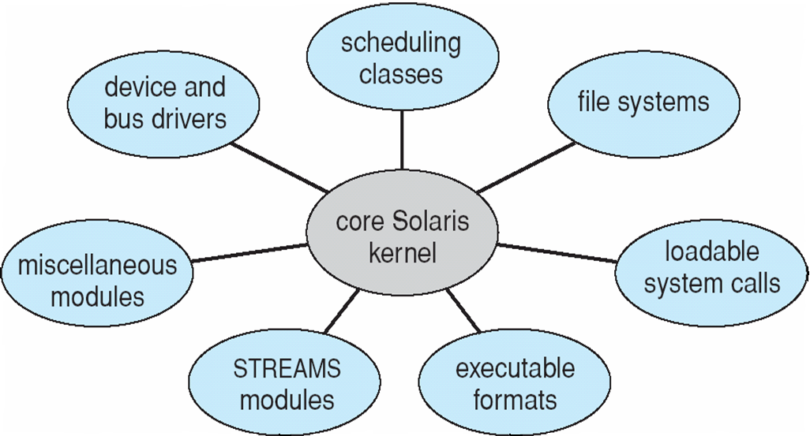
Solaris Modular Approach
62

Slide 63
Hybrid Systems
Most modern OS are not one pure model → hybrid
  combine multiple approaches → balance performance / usability
Linux & Solaris kernels monolithic & modular
  kernel in single address space → efficient
  modules for dynamic loading of functionality
Windows mostly monolithic at core
  some components exhibit microkernel like features
  provide some user-level programs & services
Apple macOS is hybrid
  kernel based on Mach microkernel
  layered architecture → in user space, apps/services
  loadable modules → kernel extensions (dev drivers, networking, etc)
63

Slide 64
Android & iOS
Android
  kernel based on Linux – monolithic
  overall system organization – layered
    kernel → HAL → libraries → framework → apps
  components within each layer – modular
    e.g, device drivers are loadable modules
iOS
  Apple mobile OS → iPhone, iPad
  combines elements of monolithic & microkernel designs
  Core OS → structured on macOS
64

